Slide 1



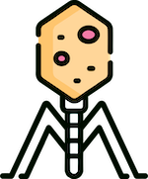

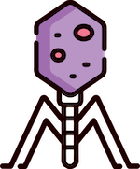



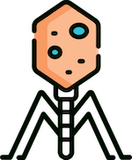
MSC COMPUTATIONAL SCIENCES THESIS DEFENSE
VICTOR PIASKOWSKI
UNIVERSITY OF AMSTERDAM
VRIJE UNIVERSITEIT
DR. MATTI GRALKA

Slide 2

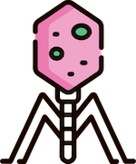



01
02
INTRODUCTION
BACKGROUND
04
05
RESULTS
ANALYSIS AND CONCLUSIONS
03
METHODOLOGY
PROJECT OUTLINE
PHAGE BIOLOGY
DASHBOARD AND ODE MODEL
COLORFUL PLOTS AND LINES!
BIGGEST TAKEAWAYS

Slide 3





01
INTRODUCTION
PROJECT OUTLINE

Slide 4






Mathematically Modeling the Interactions Between Phages, Bacteria, and the Environment
RQ1
RQ2
How do phages impact community dynamics in complex microbial communities?
How can you effectively model and interact with any pxbxr system?

Slide 5




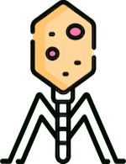
PROBLEM
Model multiple phages, bacteria and resources in complex, continuously evolving systems
10s to 100s of phages, bacteria and resources
Unique interactions and characteristics
External (environment) influence

Slide 6




CHALLENGE
Current ODE models focus on 1x1x1 or 2x1x1 systems
Niche or specific situations
Limited flexibility in modelling systems and environment
Varying or unknown conditions, model, and input

Slide 7

ANSWER
Flexible simulation framework
Network representation
Model individual variables and states (phages, uninfected/infected bacteria, resources)
Standardize input and output
Models varying model complexities
Easy to setup
Interactive GUI tool and dashboard frontend

Slide 8



02
BACKGROUND
PHAGE BIOLOGY

Slide 9

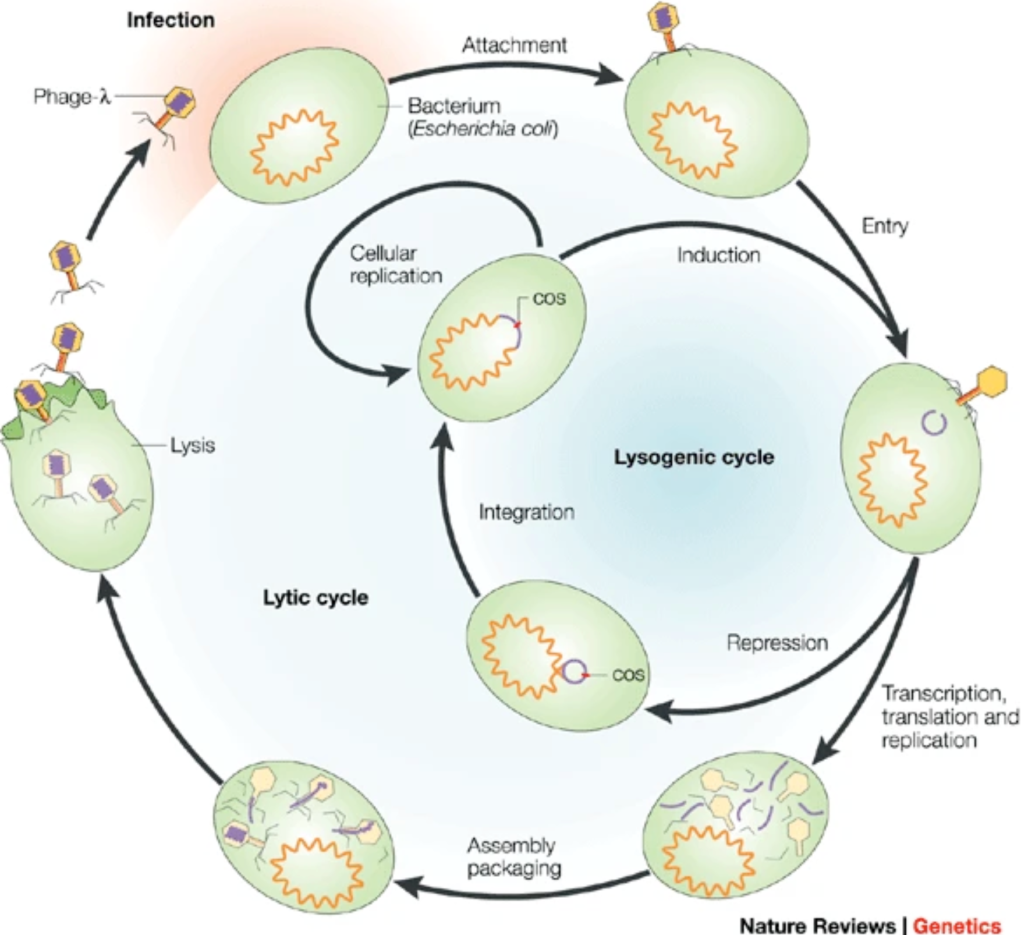
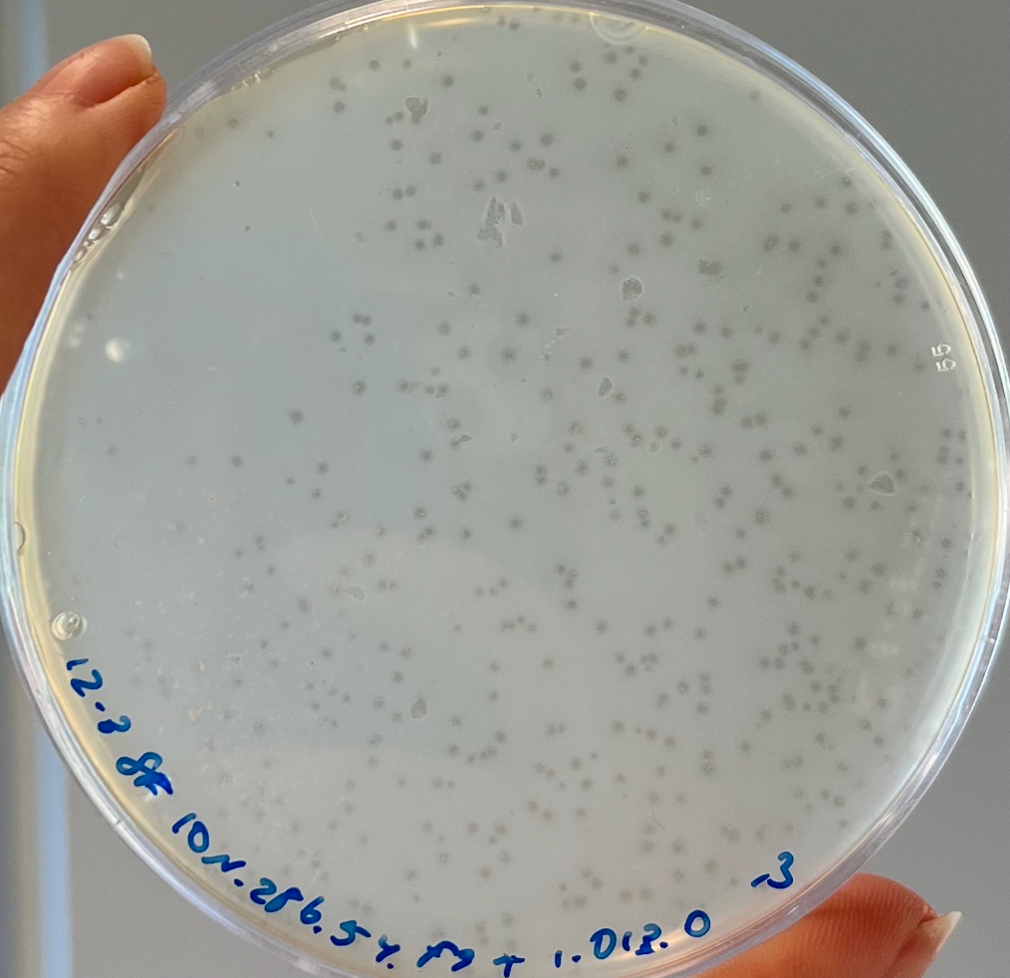
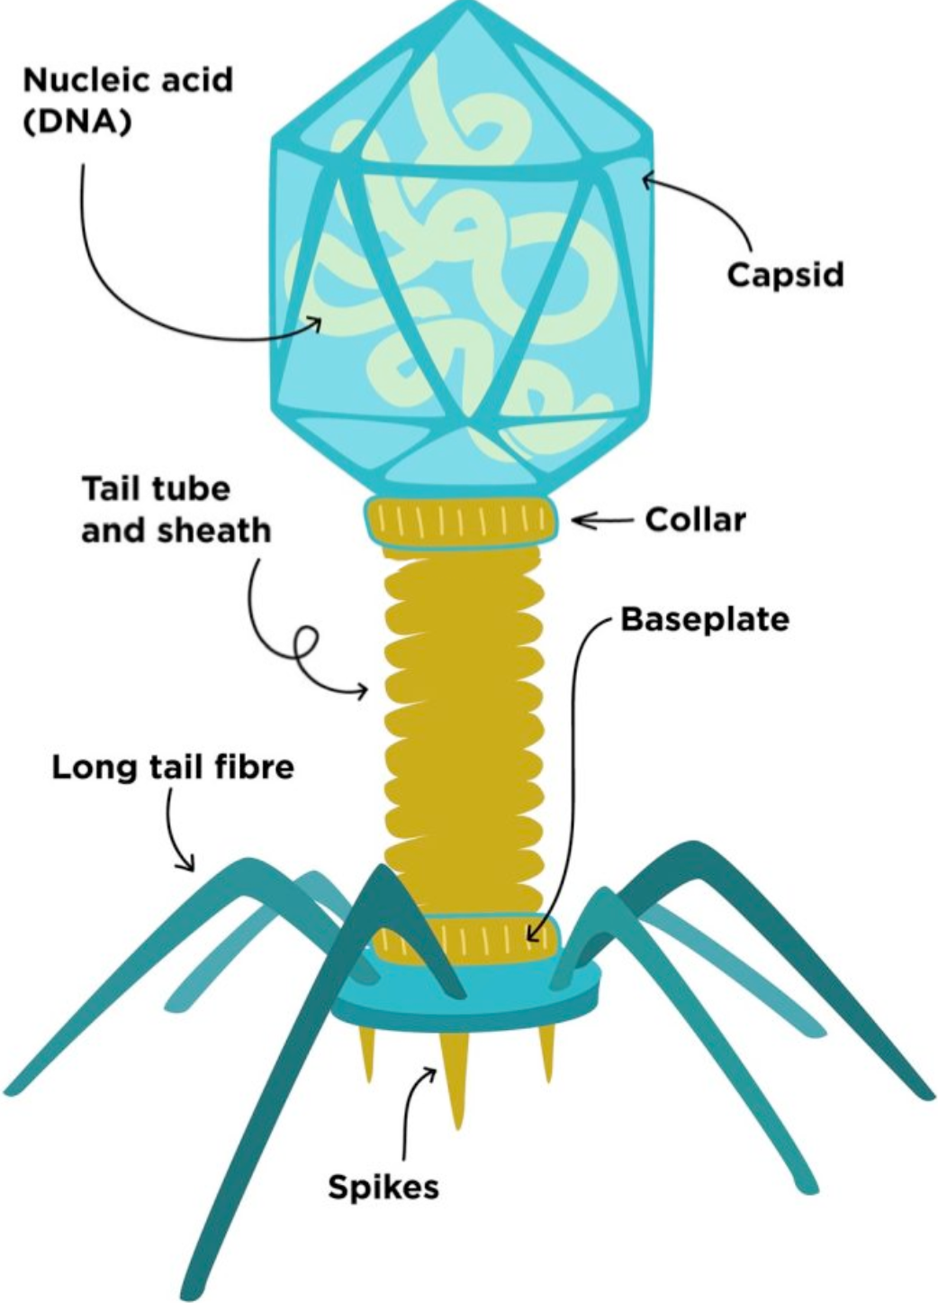
Phages in The Environment
30% of all daily marine bacteria death due to phages
Important role in nutrient turnover and bacteria fitness

Slide 10

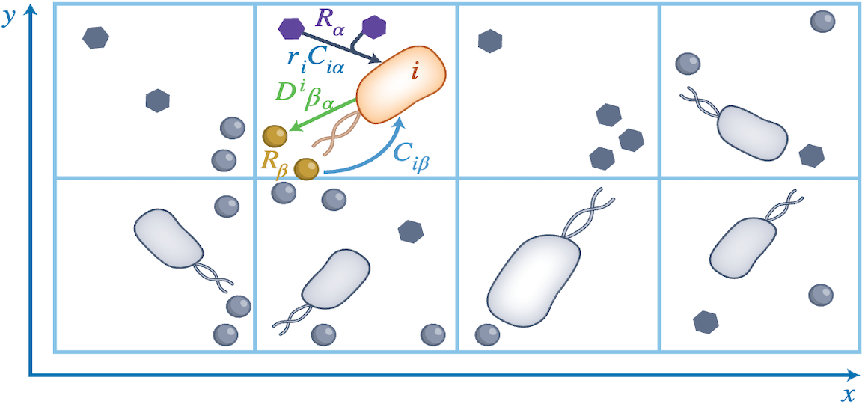
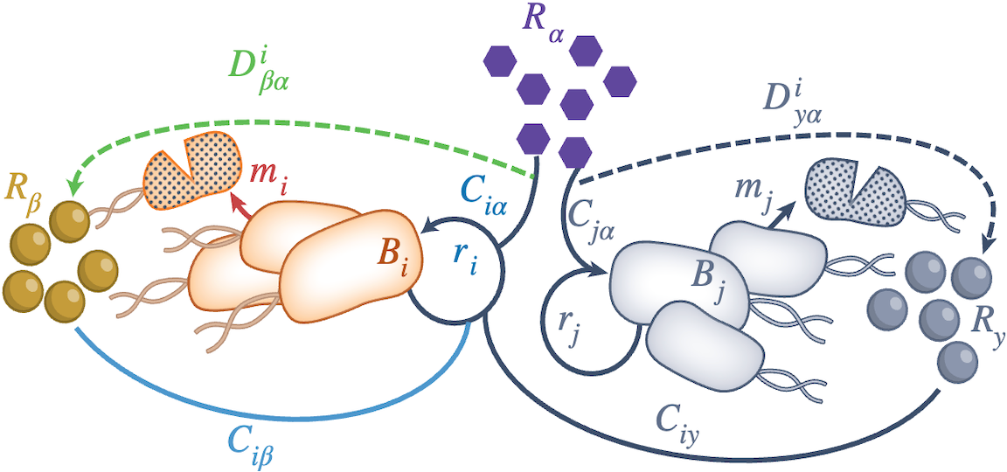

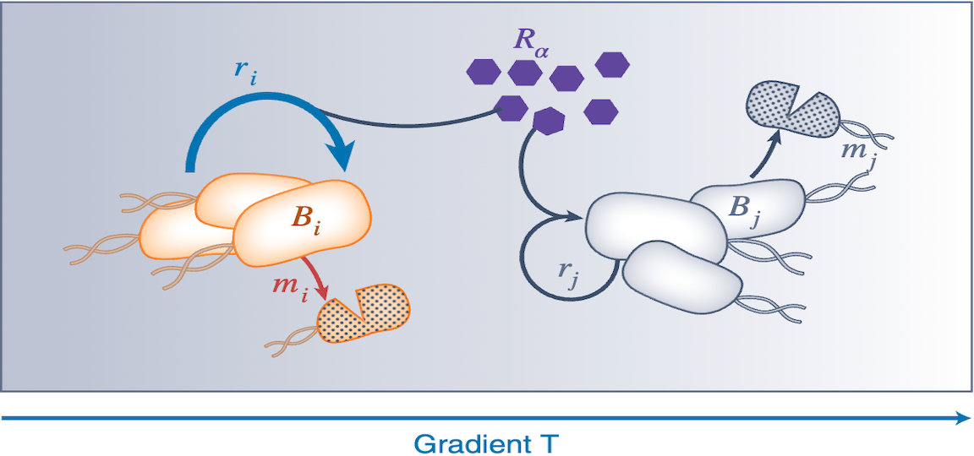
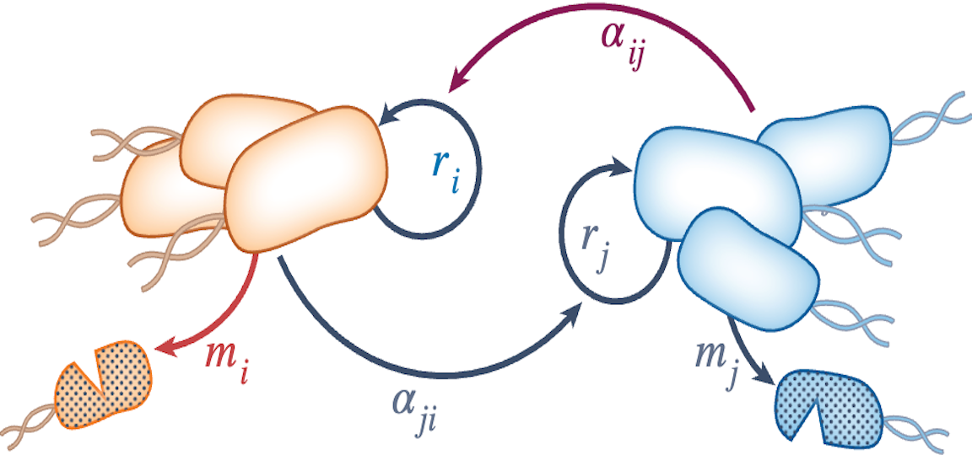
Different Models
Agent Based Model
Spatial vs. Non-Spatial Models
Consumer-Resource Model
Trait-based (PDE) Model
Lotka-Volterra Model

Slide 11
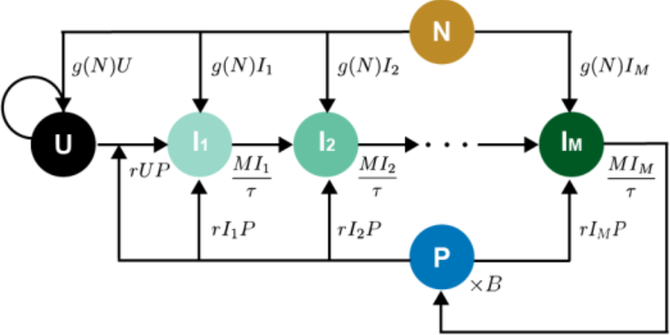
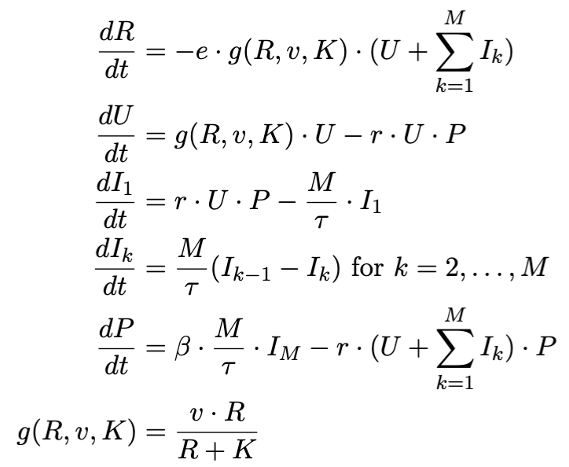
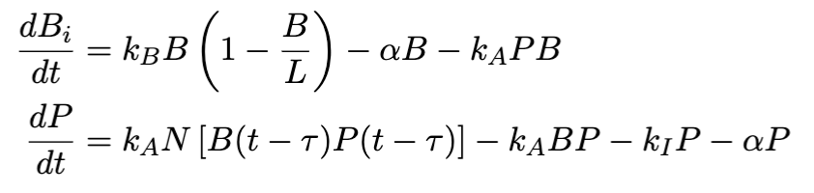
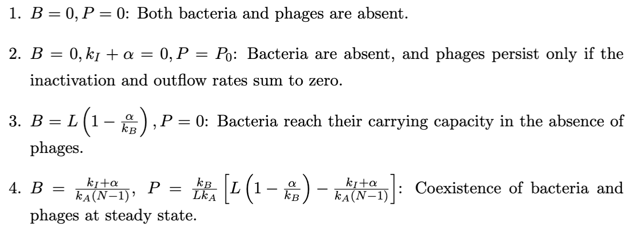
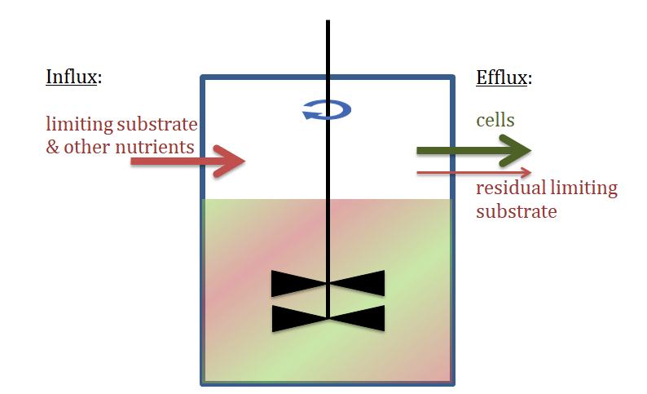
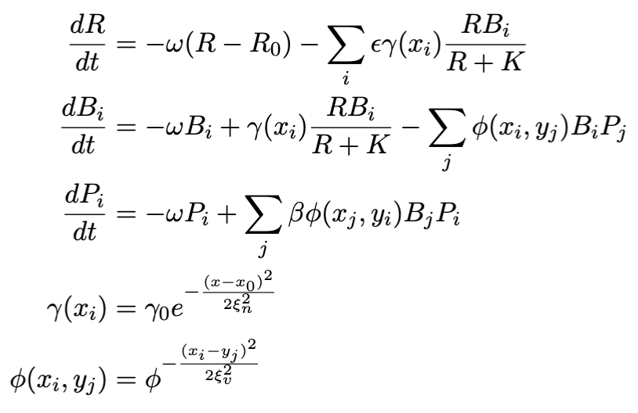
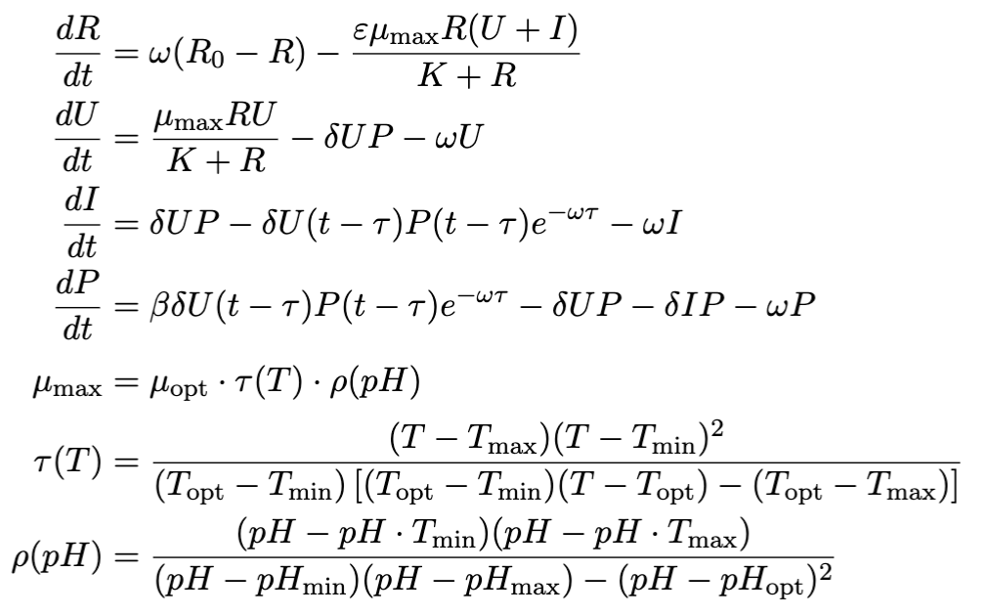
Different Models
Campbell DDE Model in a Chemostat
Golding ODE Model
Analytical stationary points
Weitz ODE Trait-Based Model
Schrag DDE Model in a Chemostat with temperature and pH

Slide 12


03
METHODOLOGY
DASHBOARD AND ODE MODEL

Slide 13
Simulation Flowchart

Slide 14
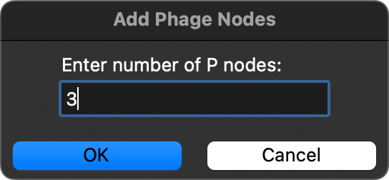
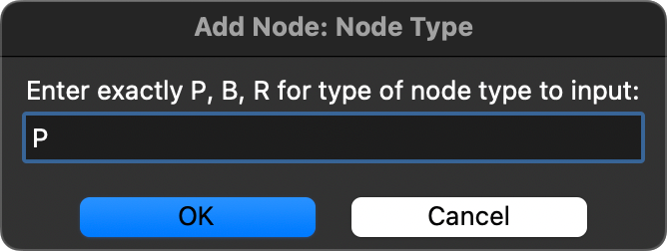

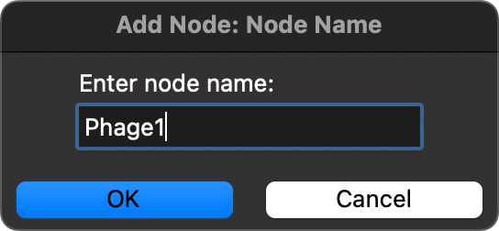
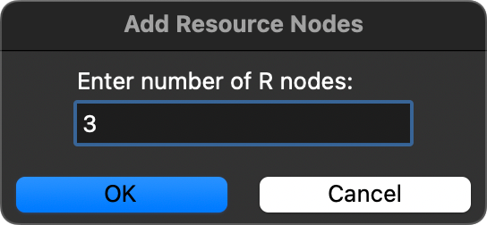
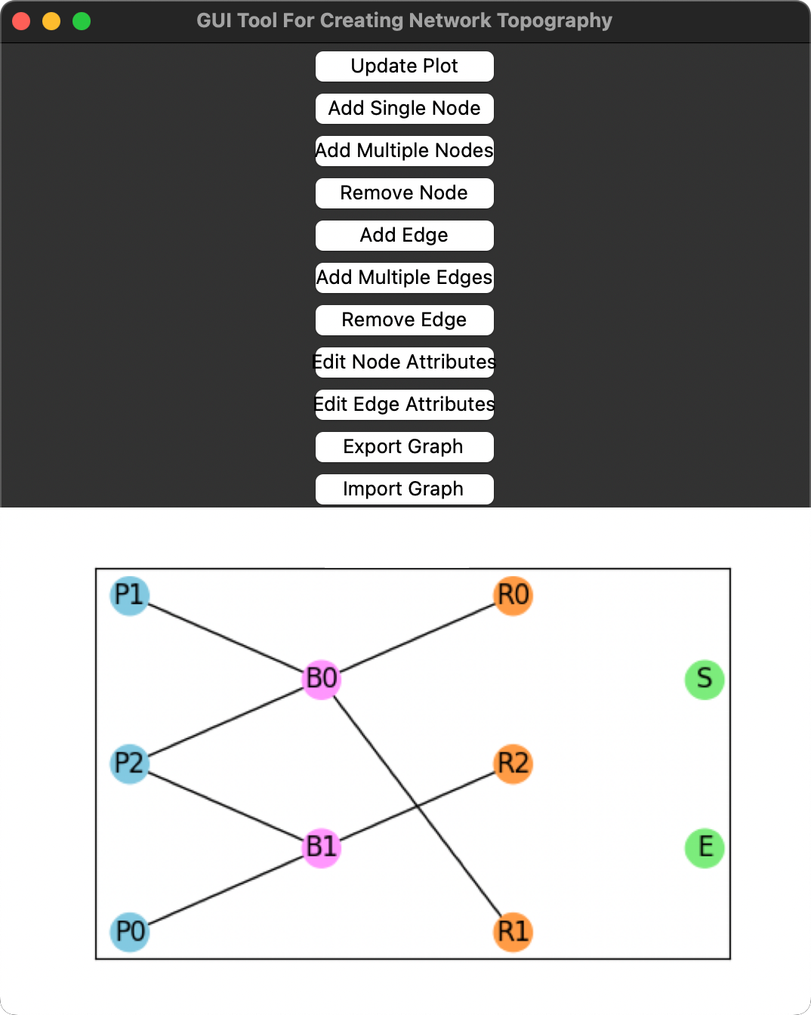
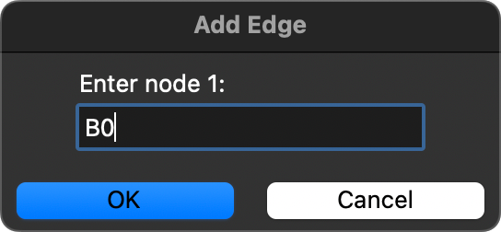
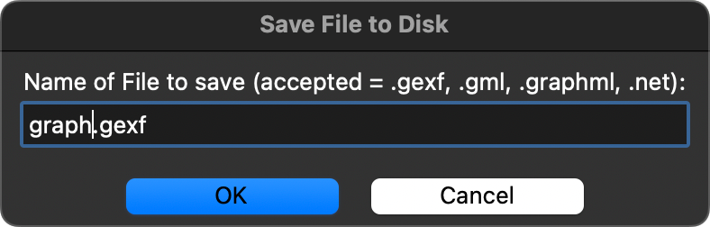
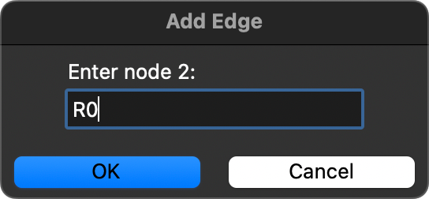
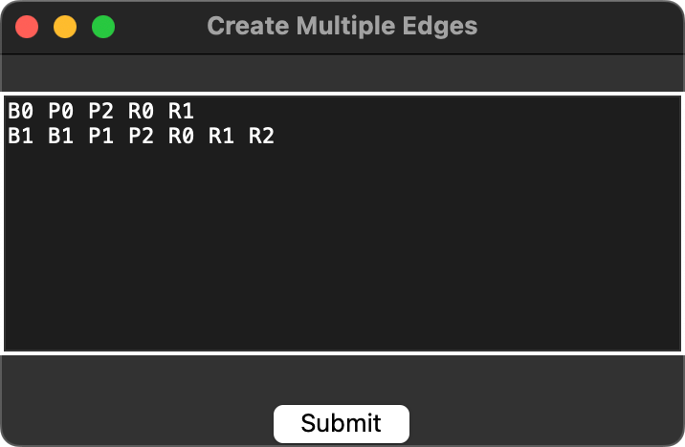
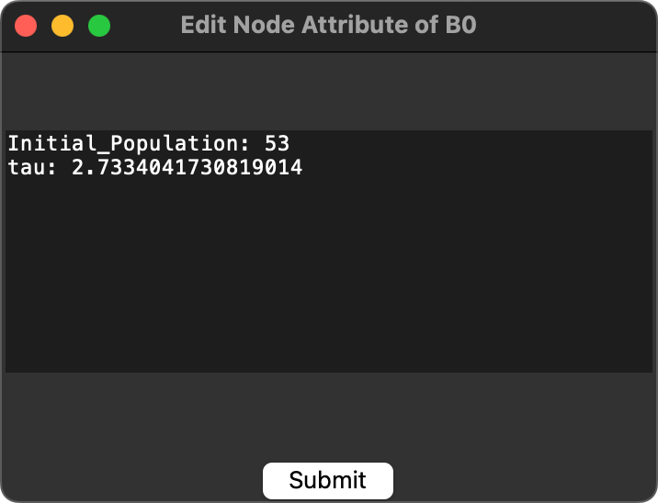
GUI Tool

Slide 15
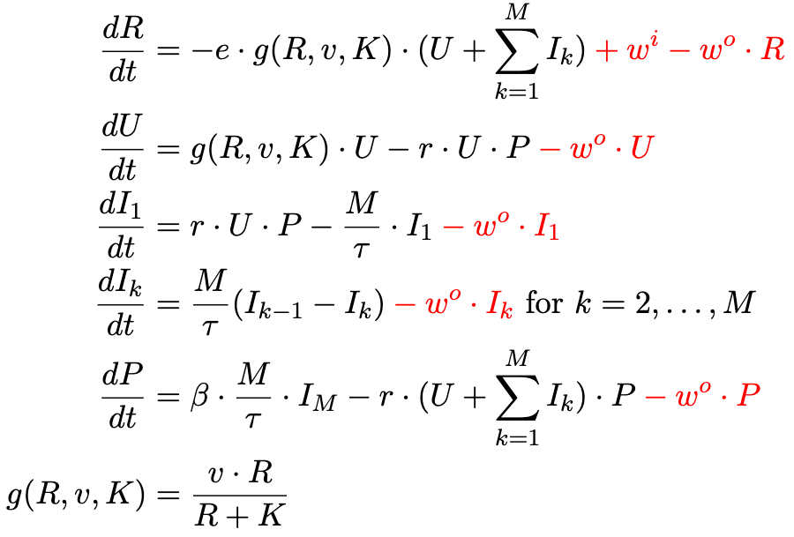
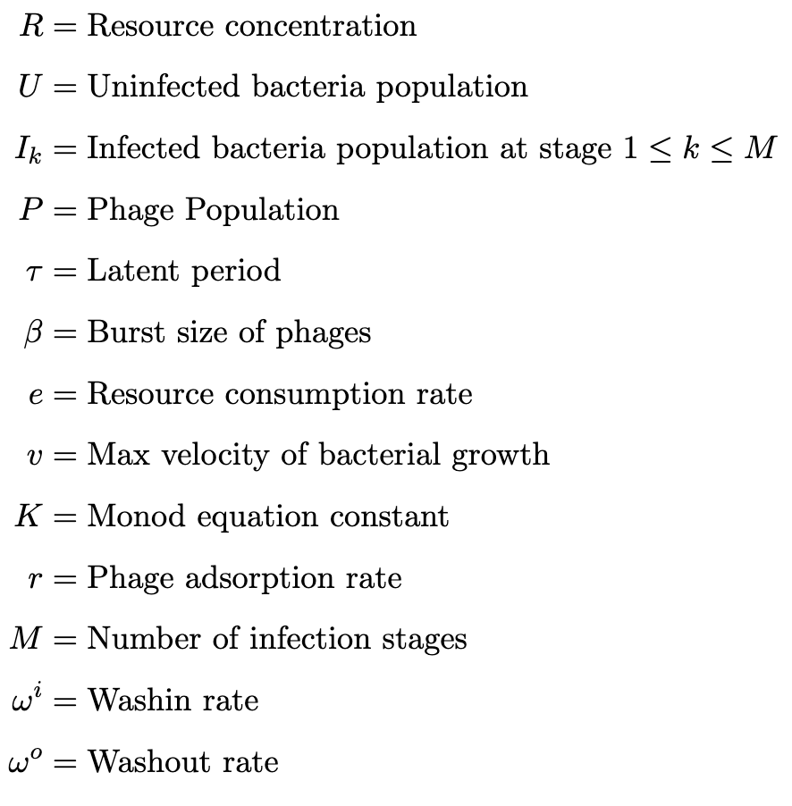
ODE Model – Golding Model

Slide 16
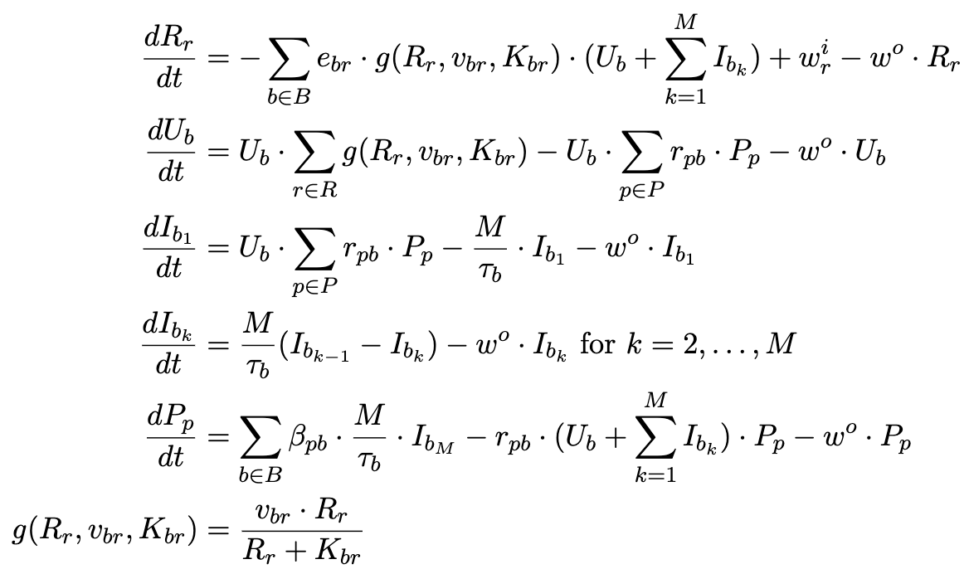
Adapted Golding Model for a pxbxr System

Slide 17
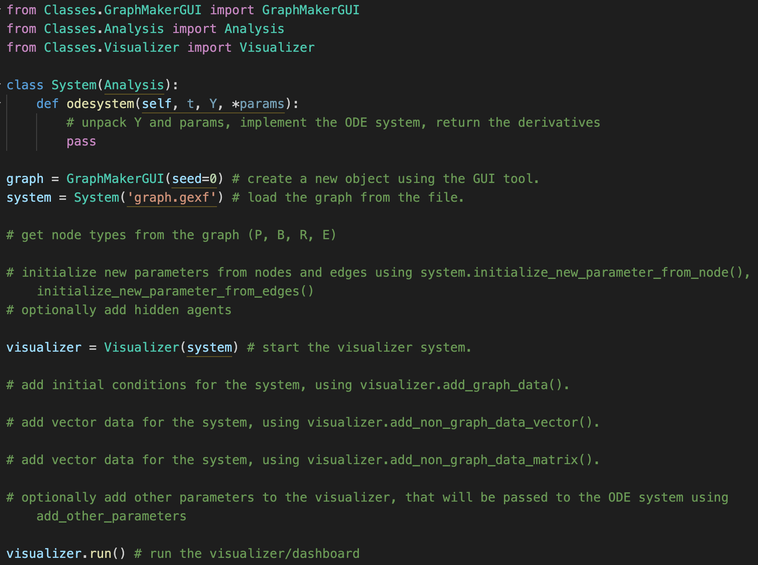
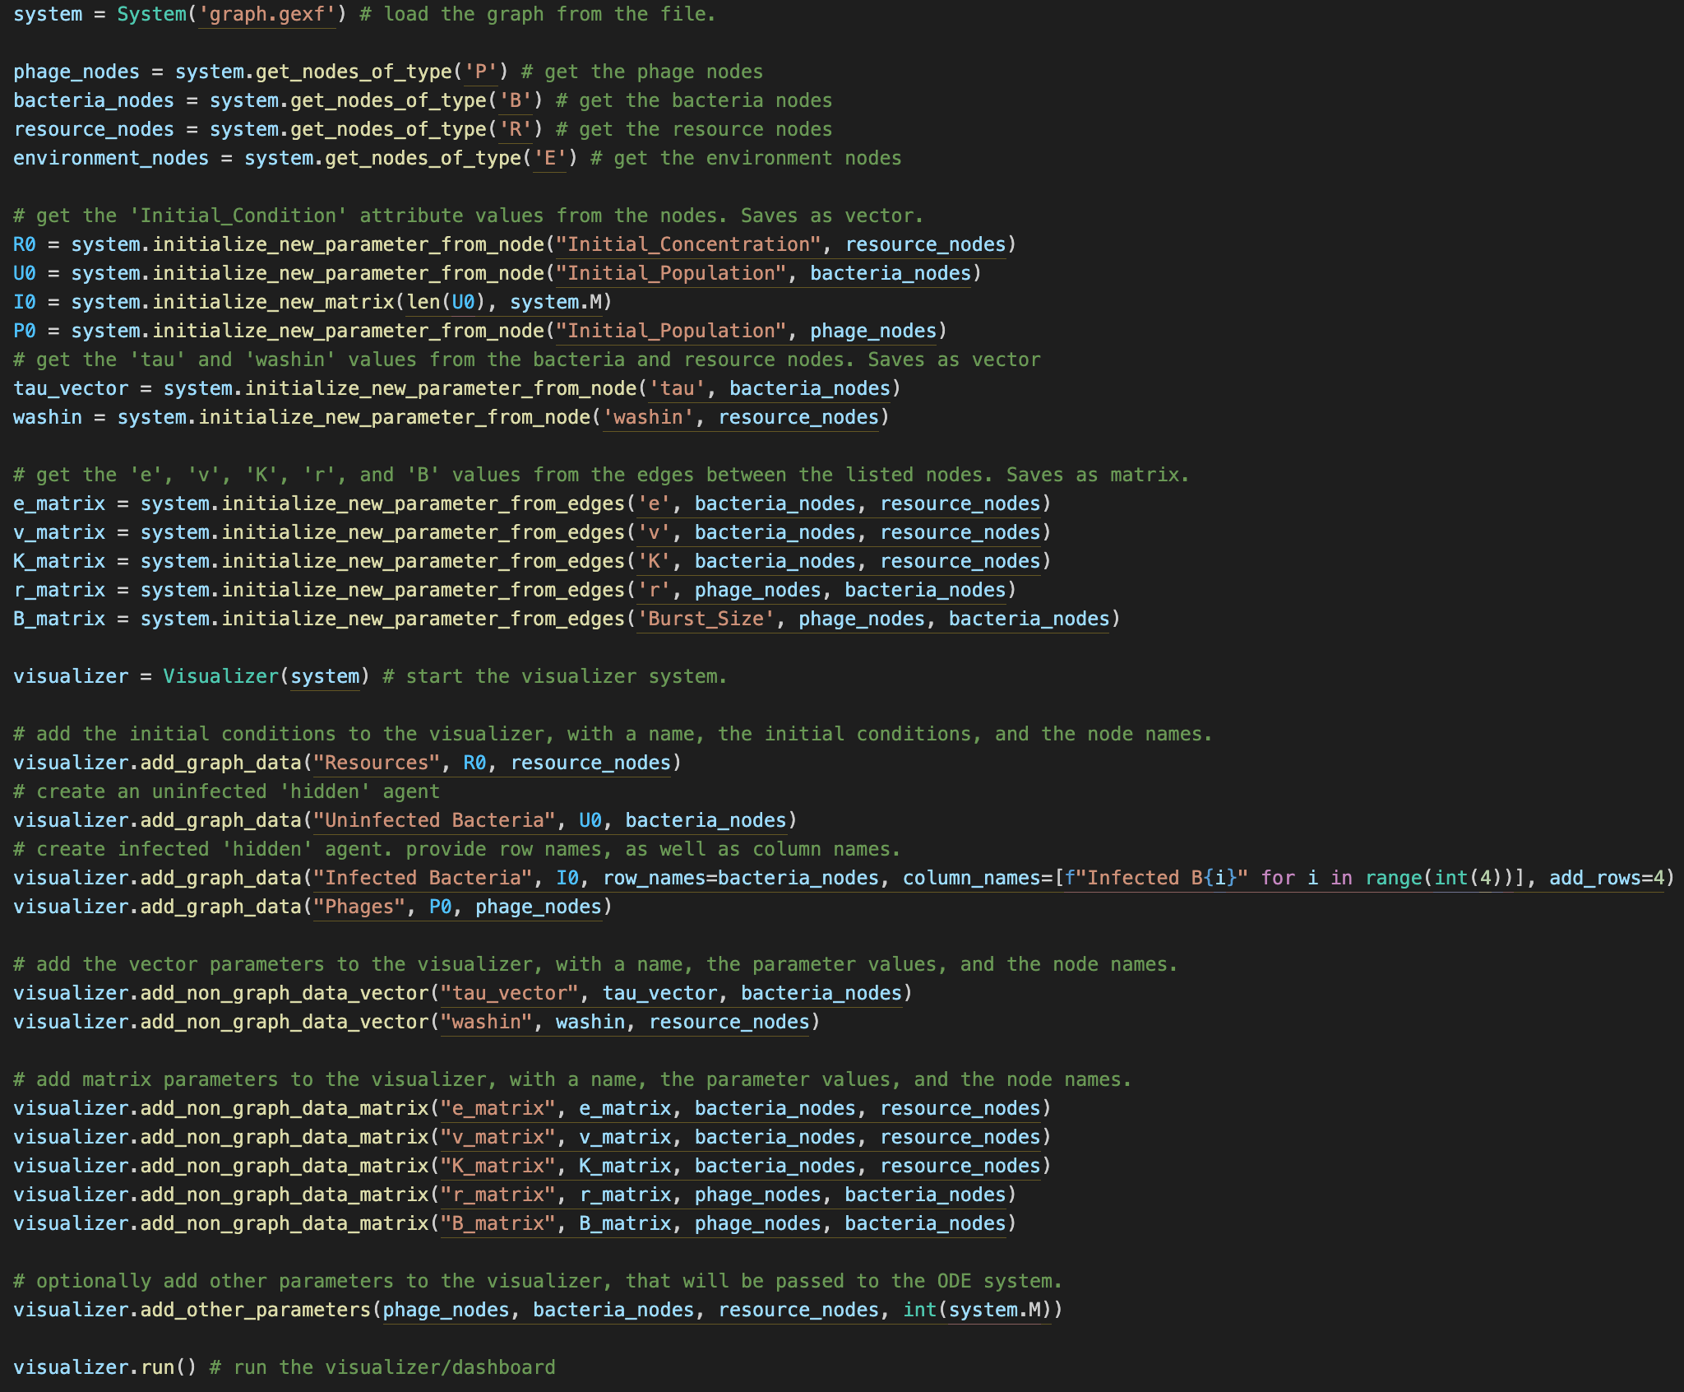
Running the Framework
Not fully automated, “manually” enter data
Low-code, boilerplate-like code
ODE code implementation

Slide 18
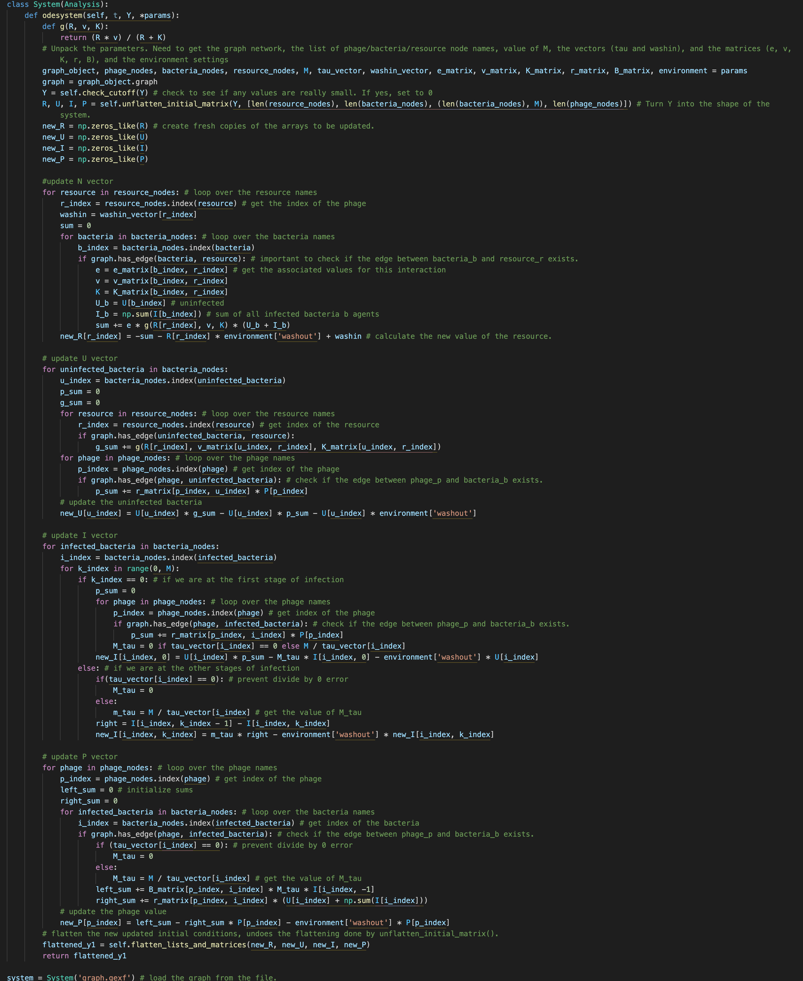
ODE Code

Slide 19
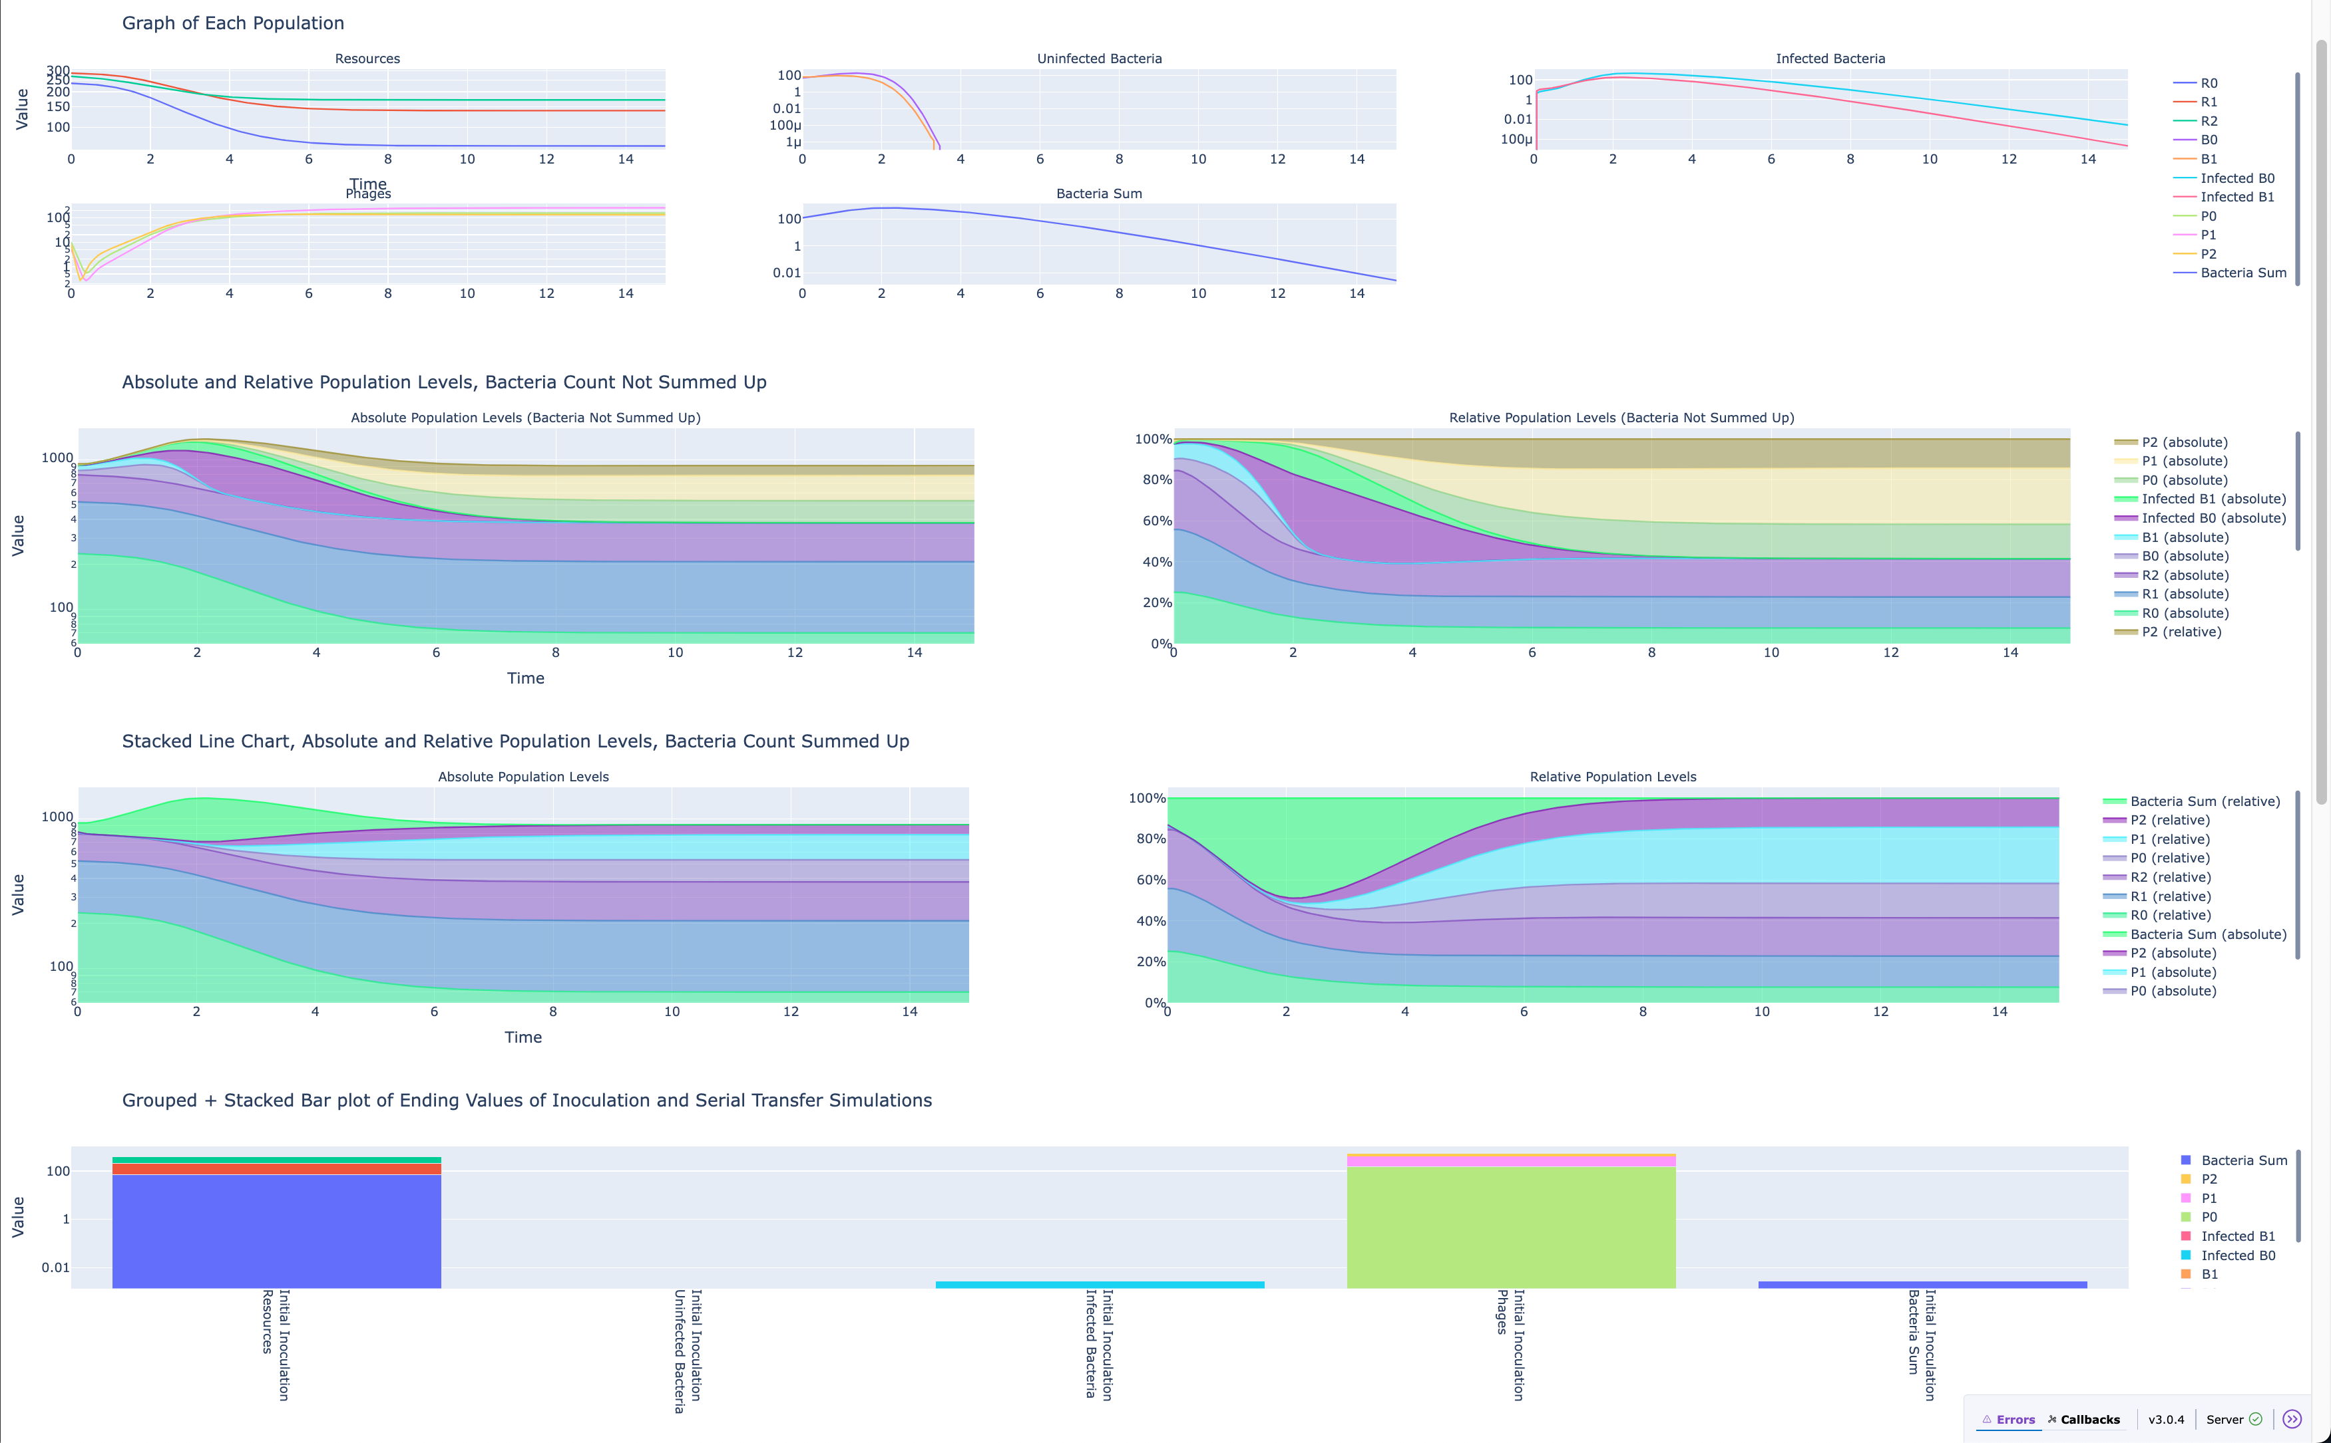
Dashboard – Plot Basic Graph

Slide 20
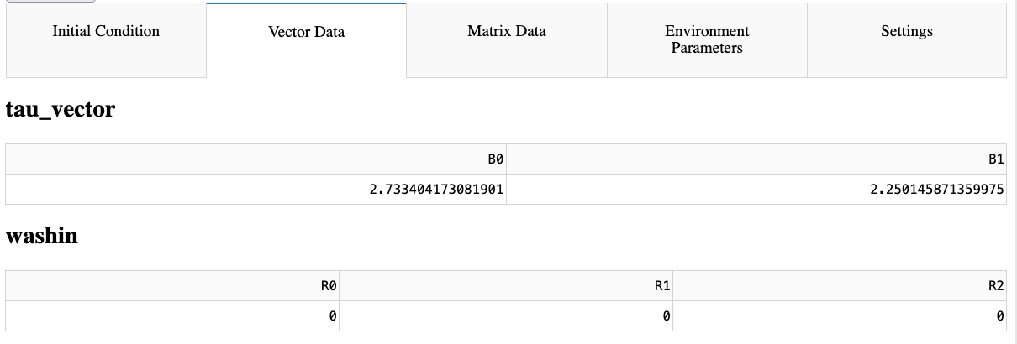
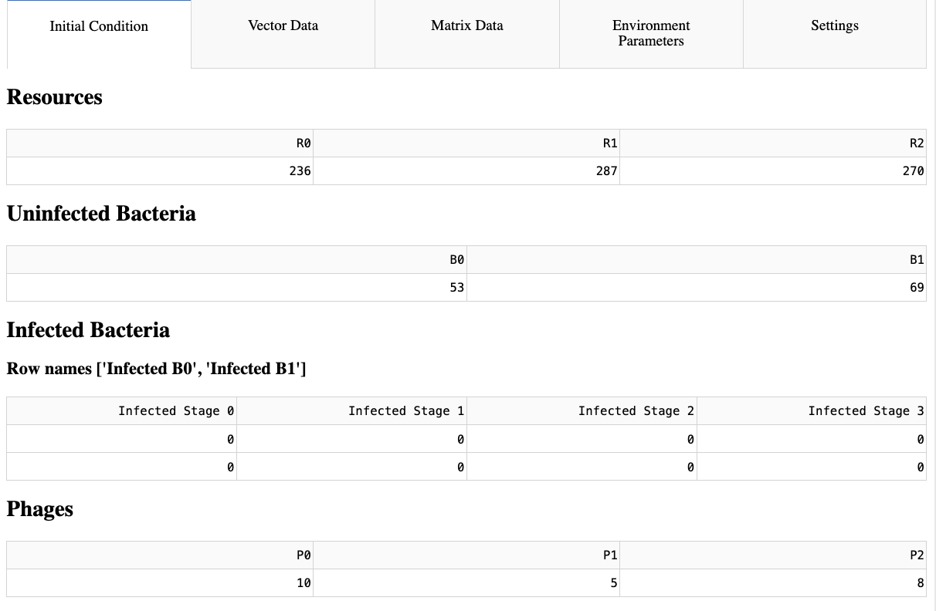
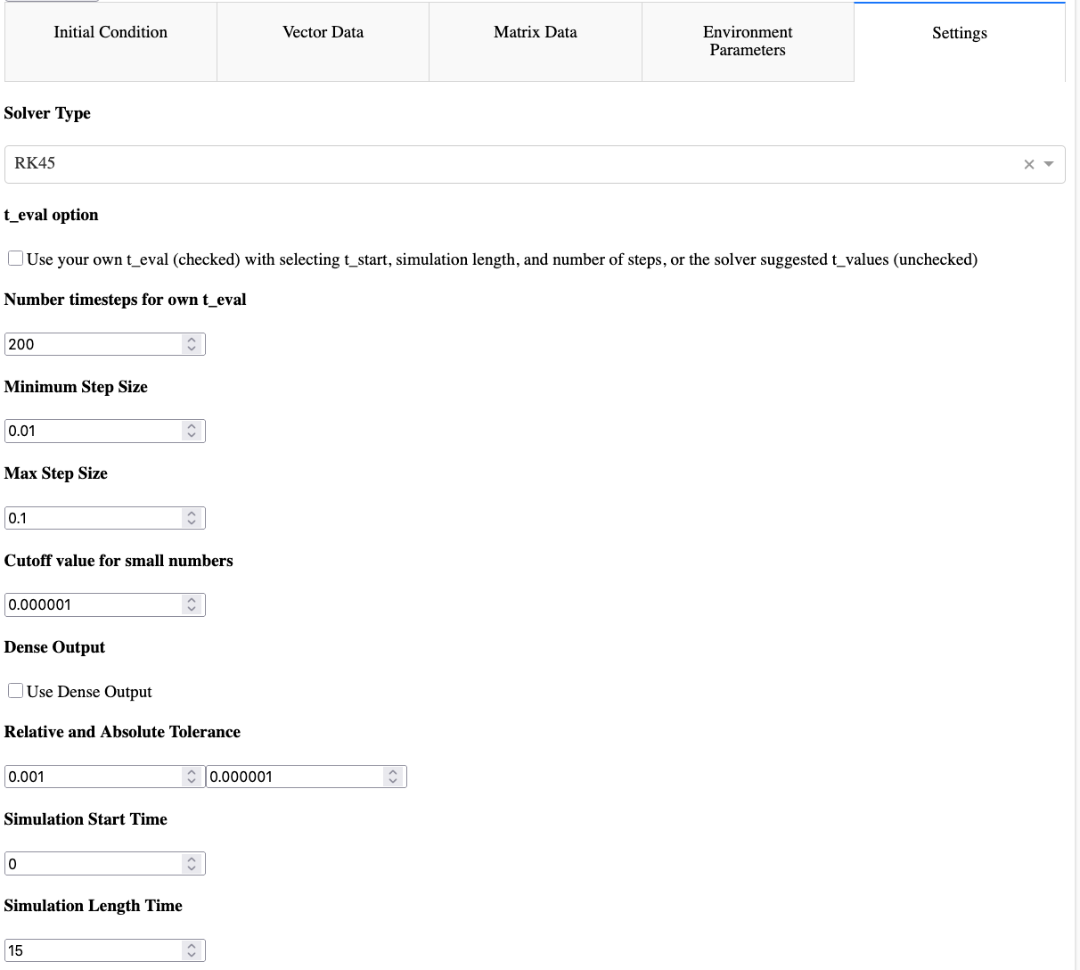
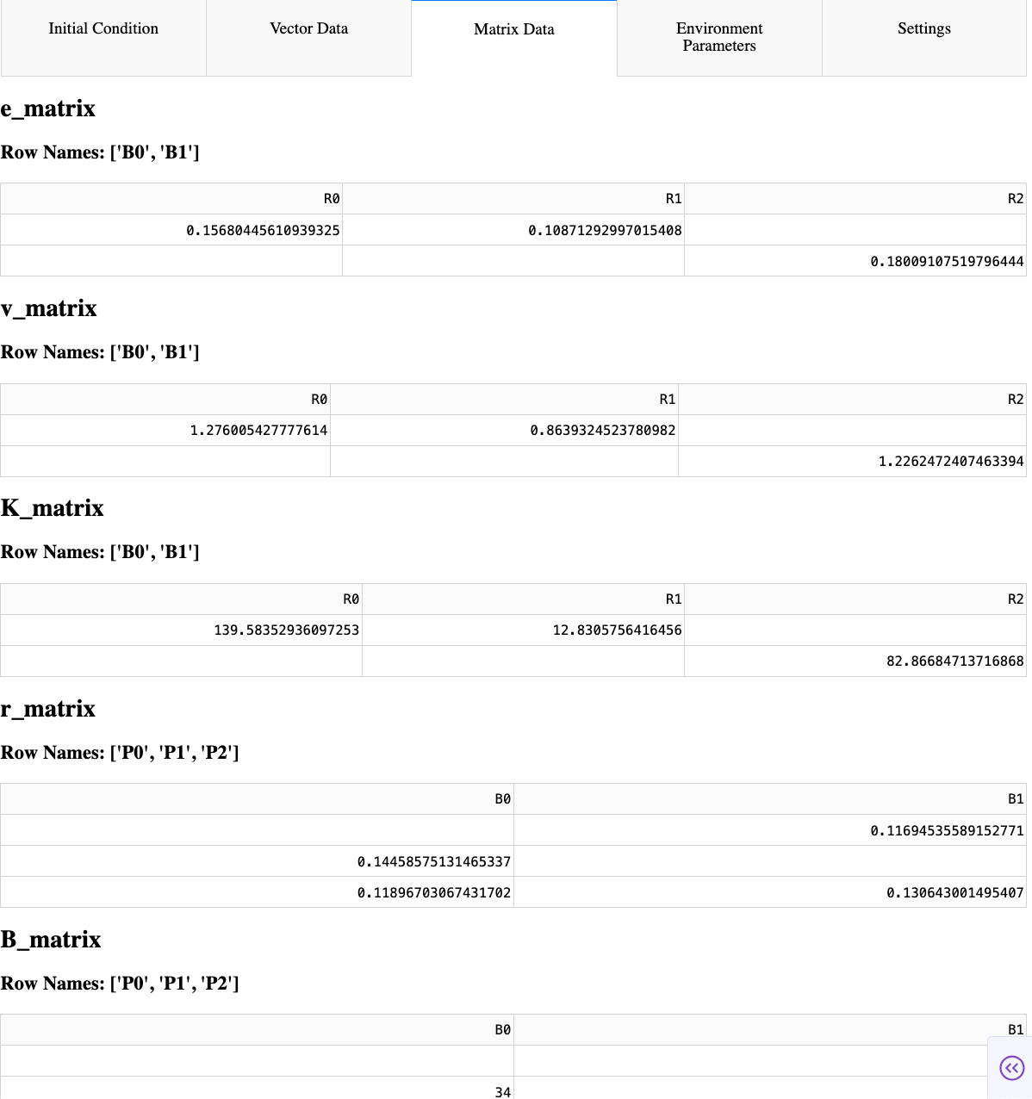
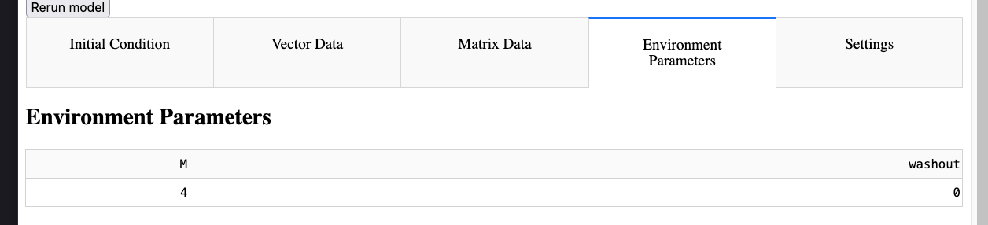
Dashboard – Edit Parameters

Slide 21
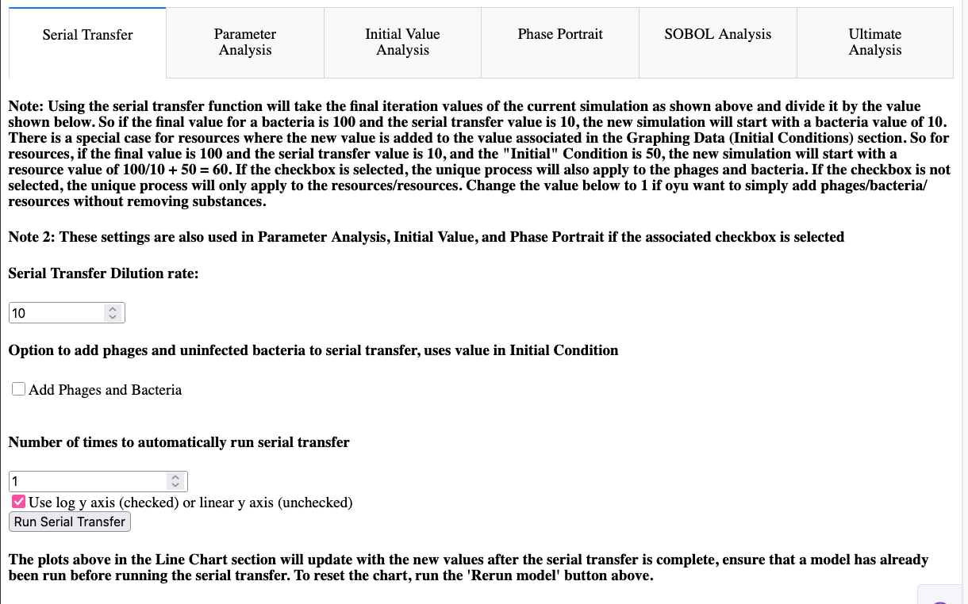
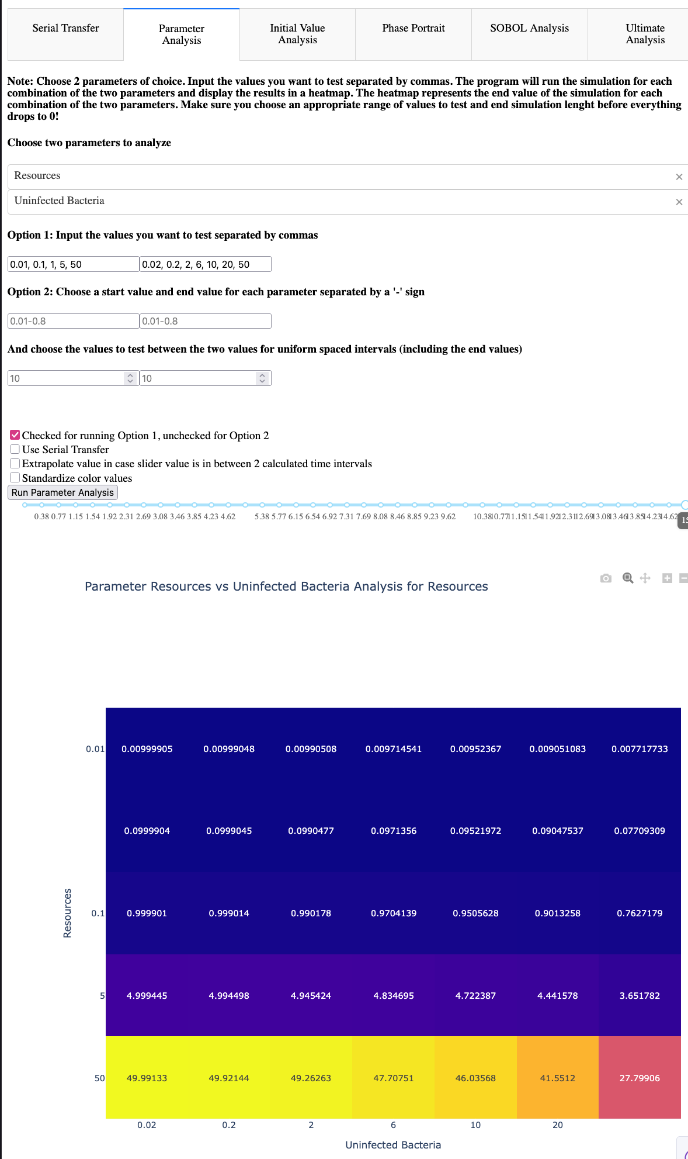
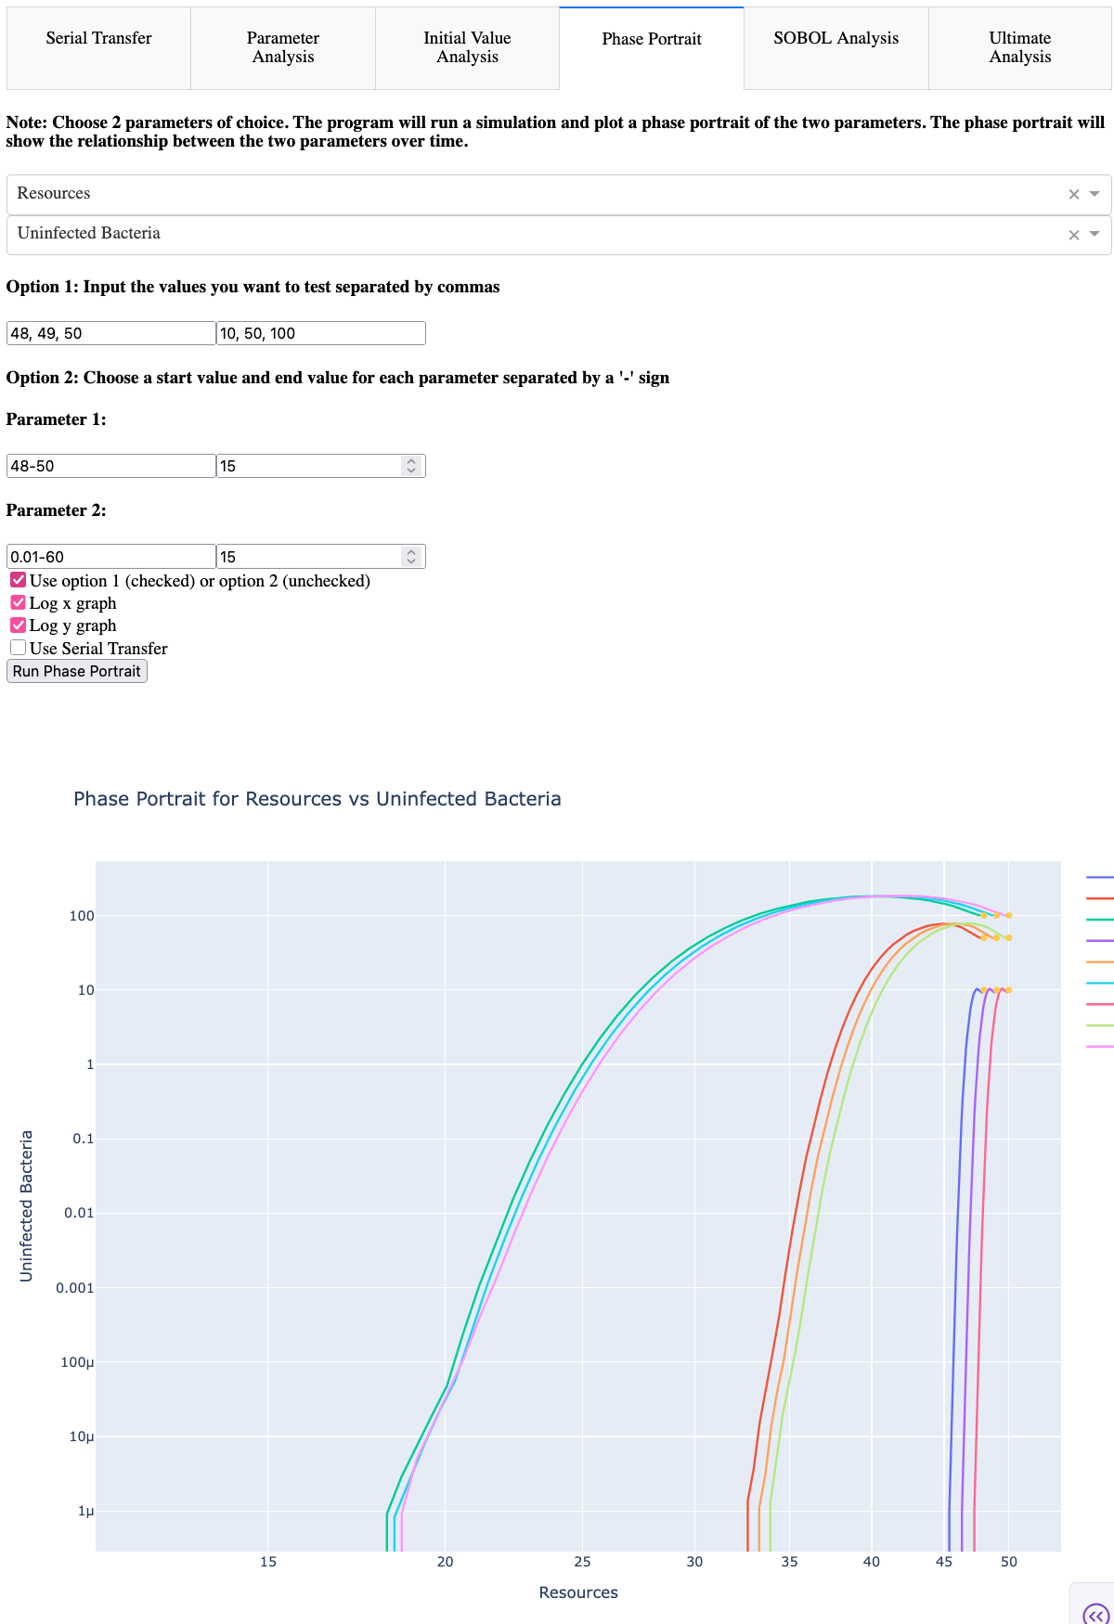
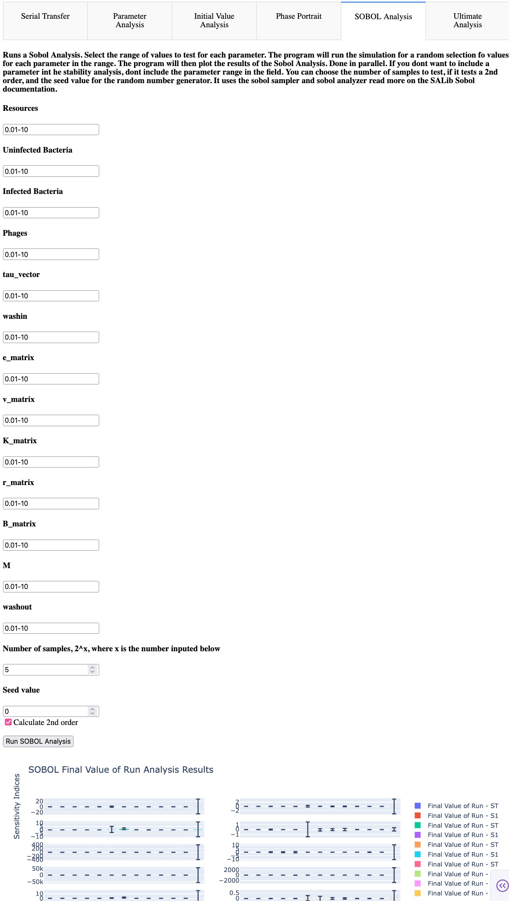
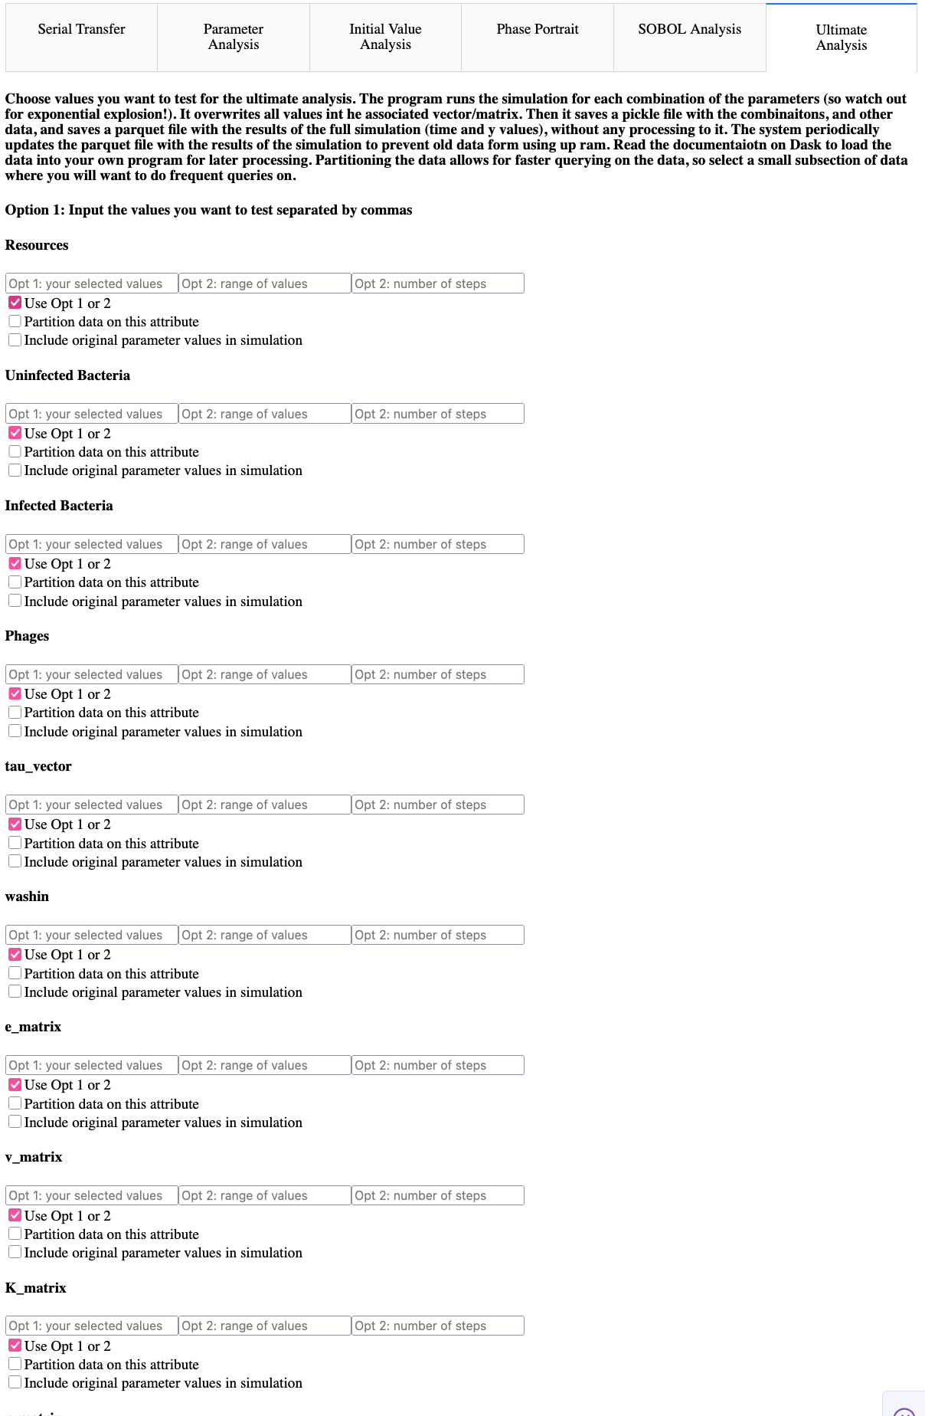
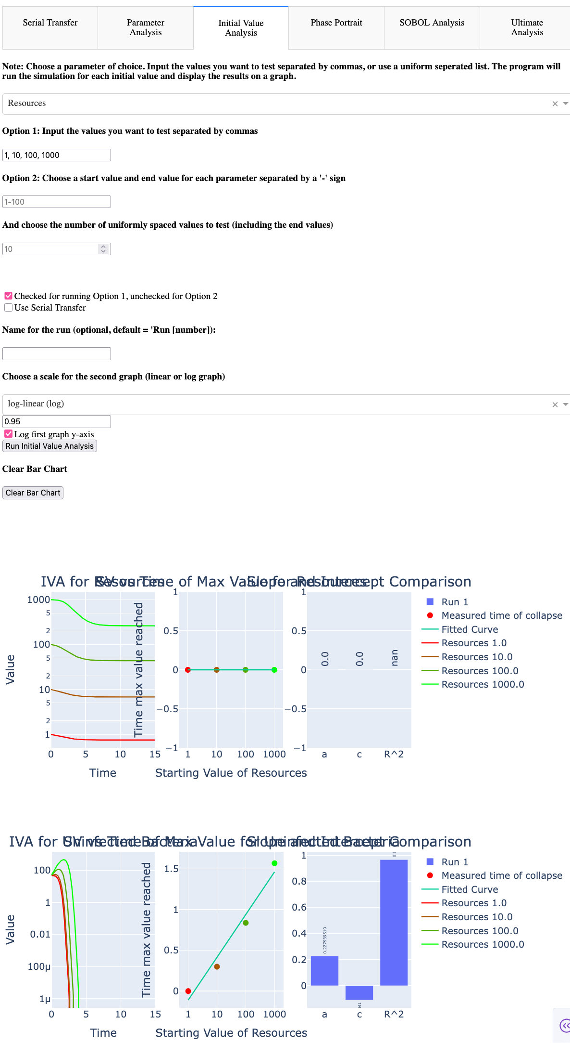
Dashboard - Advanced Analysis

Slide 22
Dashboard - Interactivity
Interaction is forefront
Selectable dropdowns
Change axis-scale
Run Serial Transfer in Advanced Analysis
Change parameter values and settings
Decide specific parameter values or range of values
Every graph element is hoverable – displays parameter condition, compare values,

Slide 23
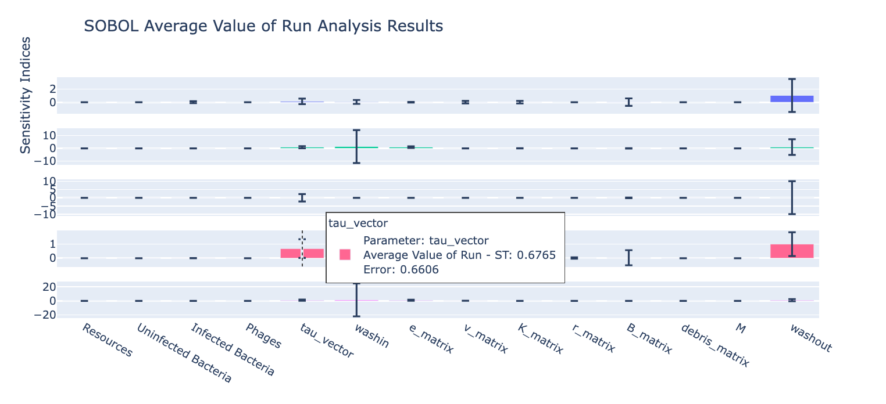
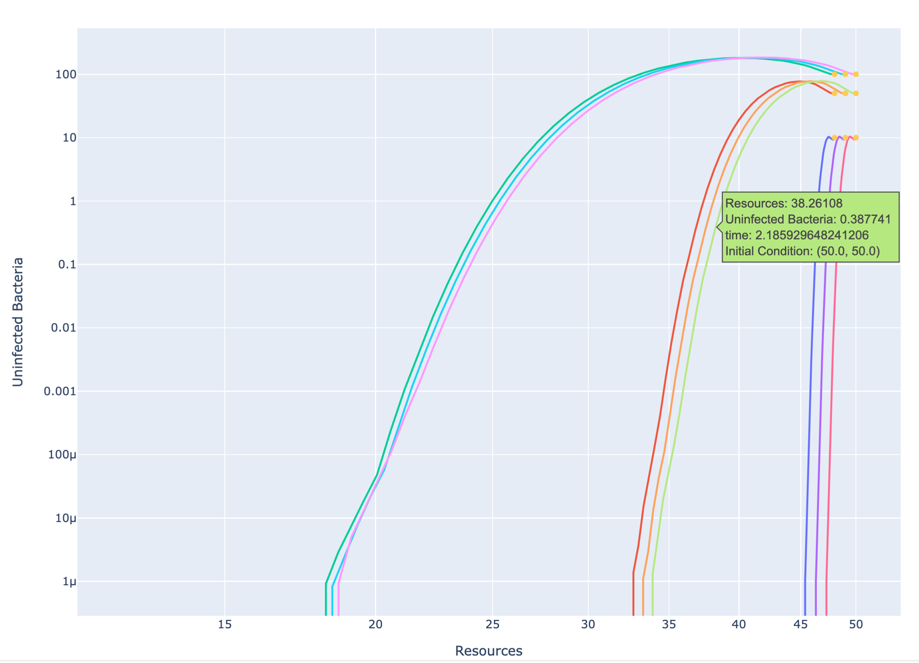
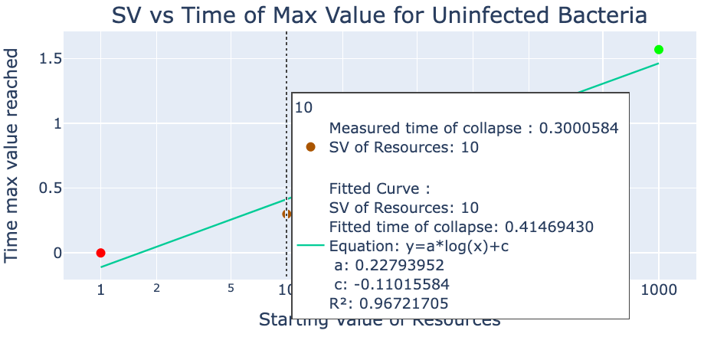




Dashboard - Interactivity

Slide 24
04
RESULTS
COLORFUL PLOTS AND LINES!

Slide 25
01
02
SOBOL
INITIAL VALUE ANALYSIS
04
05
3x2x3 MODEL
20x20x10 Model
03
PHAGE PROLIFERATION
PARAMETER SENSITIVITY
CHANGING VALUES
GRAPH BEHAVIOR
DO NOT DIE OUT!
COMPARING BEHAVIOR
SURVIVABILITY MATRIX

Slide 26




Graph Behavior - Biologist POV
Tau = 2.14 (reference graph)
Tau = 3 (slower latent time)
“As I increase tau, the latent period increases, which means it takes longer for the phages to burst, so … ”
Tau = 0.5 (faster latent time)

Slide 27



Graph Behavior – Computational Scientist POV
“I don’t know what happens if I increase tau, but I see that it greatly affects the phage peak value … ”

Slide 28



Graph Behavior – Computational Scientist POV

Slide 29
Biologist POV + Computational Scientist POV =
Greater understanding than just individually!

Slide 30
Combined Understanding
Tau = 2.14 (reference graph)
Tau = 3 (slower latent time)
Tau = 0.5 (faster latent time)
“I see that tau does not significantly affect peak value, but rather the time of peak. I know this because tau mainly affects the time to burst, so more phages are created earlier, causing a faster rise in population growth, which … ”

Slide 31
05
ANALYSIS AND CONCLUSIONS
BIGGEST TAKEAWAYS

Slide 32



Next Steps
CODE
LAB
MODEL
Documentation + Code Cleanup
Ready to Use Code Samples
New tools and features
Compare Lab Data to Model Data
Create Custom ODE Model for the Lab
Replicate Environmental and Lab Data
Fine-tune model parameters and equation
Compare different model outputs
Adapt or create new models (debris term)

Slide 33
GUI and Dashboard Demo*
*Only if time allows and there is interest

Slide 34
BIBLIOGRAPHIC REFERENCES
AUTHOR (YEAR). Title of the publication. Publisher
AUTHOR (YEAR). Title of the publication. Publisher
AUTHOR (YEAR). Title of the publication. Publisher
AUTHOR (YEAR). Title of the publication. Publisher
AUTHOR (YEAR). Title of the publication. Publisher
AUTHOR (YEAR). Title of the publication. Publisher
AUTHOR (YEAR). Title of the publication. Publisher
AUTHOR (YEAR). Title of the publication. Publisher
AUTHOR (YEAR). Title of the publication. Publisher

Slide 35
THANK YOU

